Slide 1
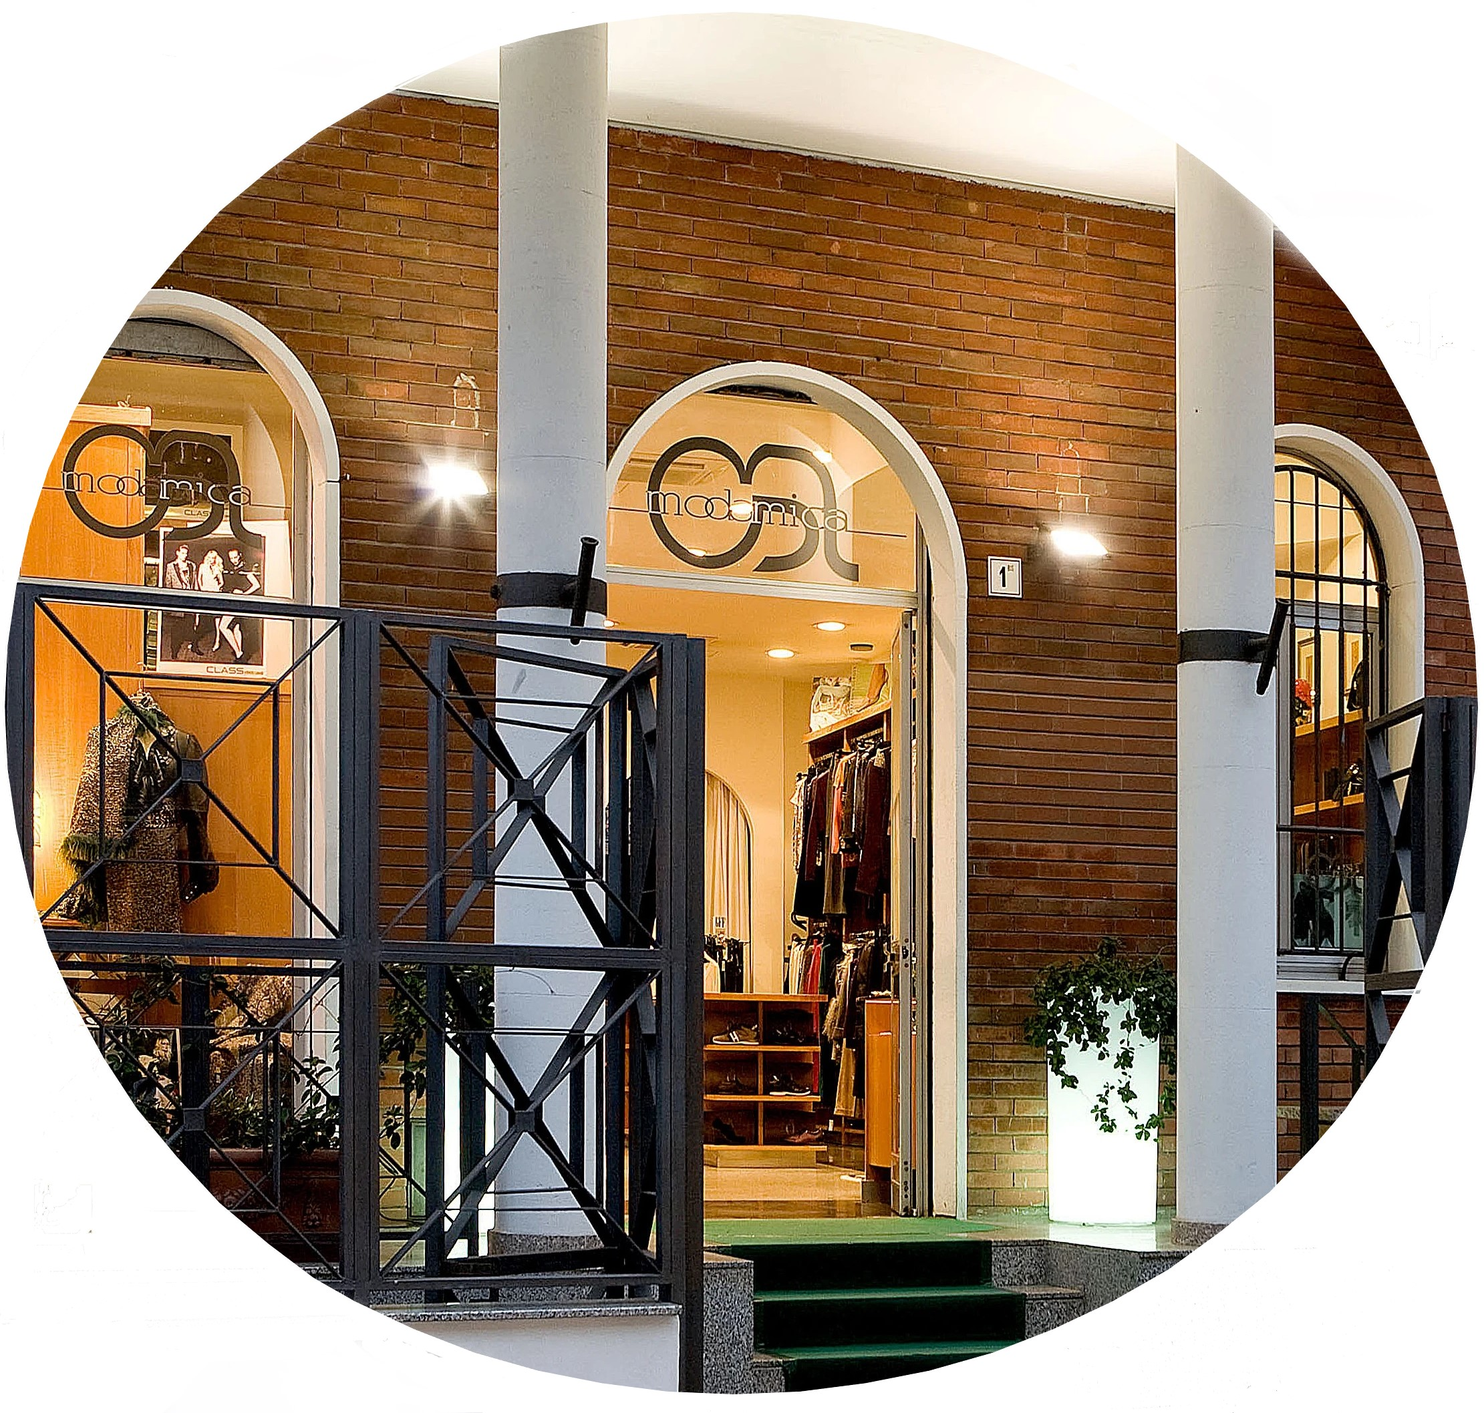
Founded in 1999 Modamica is a multibrand fashion company, born from passion for Italy’s tradition of style.
We are unique in this sector, thanks to important relationship with renowned designers.
Modamica创立于1999年，是一家多品牌时装公司，公司诞生于对意大利传统风格的热情。
得益于与知名设计师的重要关系，我们在这个领域独一无二。
Notes:
1

Slide 2
In this time of great change in the world and in all markets, we are looking, expecially in Asia, for partners who are ready to embrace the new opportunities that italian fashion offers.
These are the current markets with which we have been collaborating for years:
在当下这个国际和所有市场发生巨大变化的时代，我们正在寻找准备好迎接意大利时尚新机遇的合作伙伴，由其是亚洲的合作伙伴。
我们多年来与这些市场合作:
韩国
澳大利亚
土耳其
俄国
阿联酋
日本
欧洲
Notes:
2

Slide 3
Partners:
伙伴：
范思哲
卡尔·拉格斐
布鲁内洛·库奇内利
罗伯特·卡沃利
Fabiana Filippi
Trussardi
西萨尔·帕奇奥提
劳伦娜·安东尼奥
Missoni
卡沃利
Joseph Ribkoff
独特个性
斐乐
Angelo Marani
Andrè Maurice
Diana Gallesi
麦丝玛拉
琪亚拉·法拉尼系列
Kori Sandals
Versace
Karl Lagerfeld
Brunello Cucinelli
Roberto Cavalli
Fabiana Filippi
Trussardi
Cesare Paciotti
Lorena Antoniazzi
Missoni
Justcavalli
Joseph Ribkoff
Caractère
Fila
Angelo Marani
Andrè Maurice
Diana Gallesi
MaxMara
Chiara Ferragni Collection
Kori Sandals
Meet us and discover more!
认识我们，了解更多！
Notes:
3

Slide 4
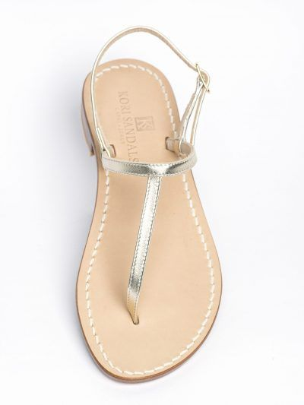
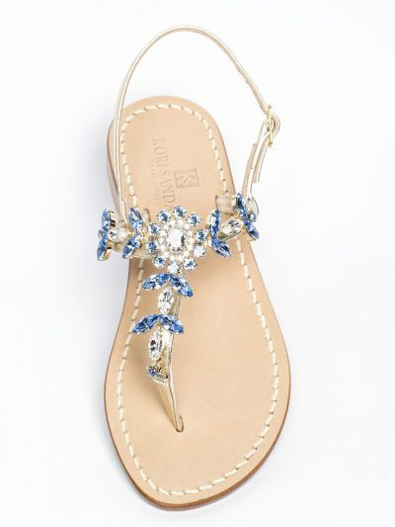
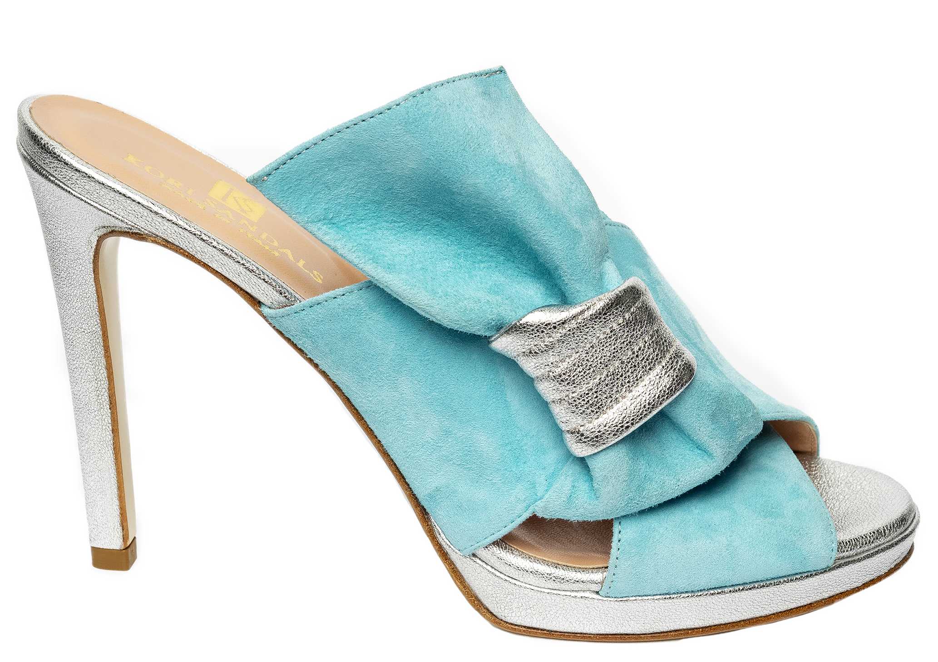
worldwide partner
100% italian manufacture
全球合作伙伴
100％意大利制造商
Notes:
4

Slide 5
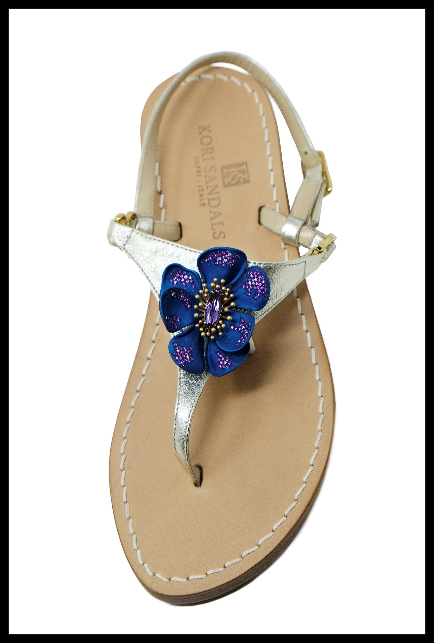
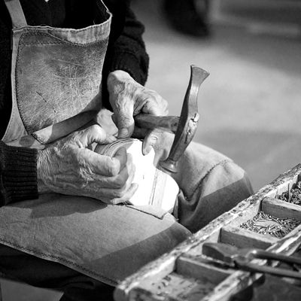
CRAFTSMANSHIP PRODUCTION
Each shoe is handmade, using processes of ancient origin and materials of the highest quality. Our selected craftsmen use certified Vero Cuoio di Toscana and apply Swarovski crystals with the utmost care.
Some models of sandals and shoes, despite their simple and elegant style, have been made thanks to long and complex production processes. All this translates into a product of the highest quality possible.
生产工艺
每只鞋都使用古老的工艺和最优质的材料，手工制作。我们精选的工匠使用经过认证的纯正托斯卡纳皮革，精心点缀施华洛世奇水晶。
即使是设计风格简约大方的部分款式凉鞋和鞋履，也须要经过数小时的生产流程。确保全部产品的具备最高的品质。
Notes:
5

Slide 6
Our experiences around the world and China, have provided us with the tools to understand foreign markets and to successfully manage orders, logistics, certifications and after-sales worldwide.
在世界和中国的经验，让我们拥有对海外市场的深刻了解，能够成功管理全球订单、物流、认证和售后服务。
Modamica S.r.l.
Via San Remigio 1
Vimodrone -MI-
IT03008070967
www.modamica.com
posta@modamica.com
Ph.+39 02 27409477
+39 393 8981680
Modamica srl
@modamicasrl
@modamica
Notes:
6

