Slide 1
DA PIU' DI 55 ANNI, AL CENTRO DELLE RELAZIONI ITALO-INDIANE
SINCE MORE THAN 55 YEARS, AT THE CENTER OF INDO-ITALIAN RELATIONS
IICCI Institutional Presentation and
PRESENCE of ITALIAN COMPANIES in INDIA
June 2023

Slide 2
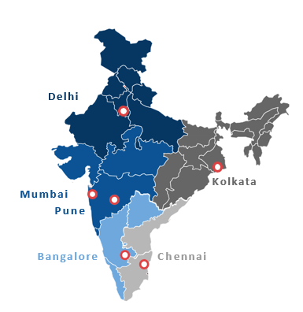
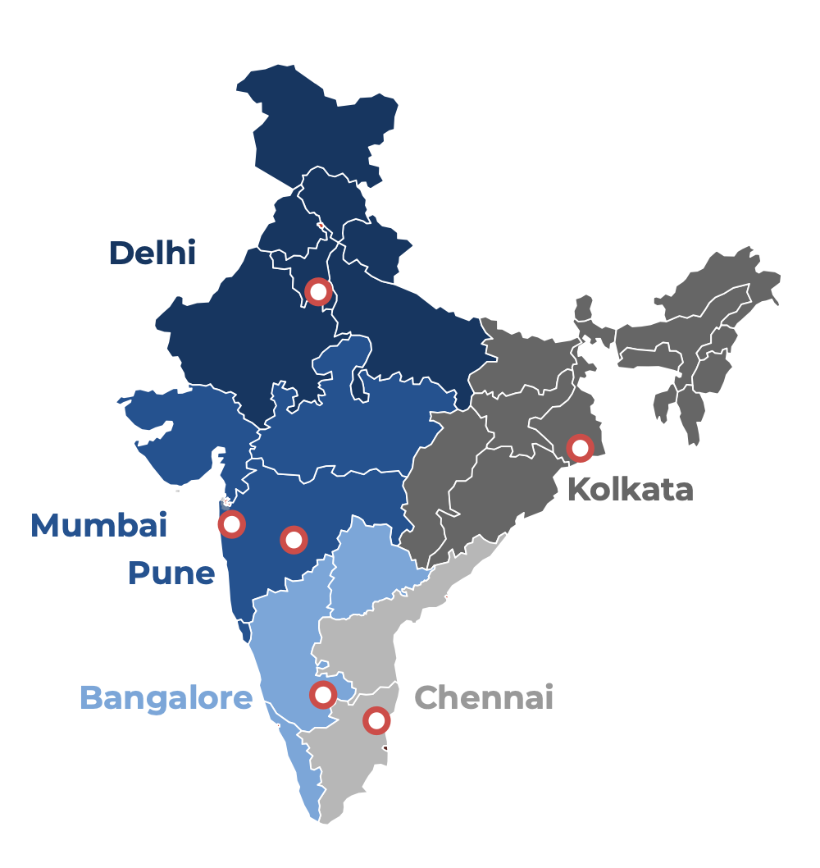
Italian Companies in India - Regions and Main Cities
Delhi NCR & North (Delhi)
Maharashtra & West (Mumbai & Pune) West Bengal & North-East (Kolkata) Karnataka & South (Bangalore)
Tamil Nadu & South East (Chennai)
= 168 companies
= 285 companies
= 20 companies
= 83 companies
= 70 companies
Italian Investments in India = 650+
Investment Stock in India from Italy since 2013 =
50 billion Eur
Employment generated by Italian companies in India: ~50k
Italian Brands present in the Indian market: +2000

Slide 3
Italian Investments Abroad – Focus India

Slide 4
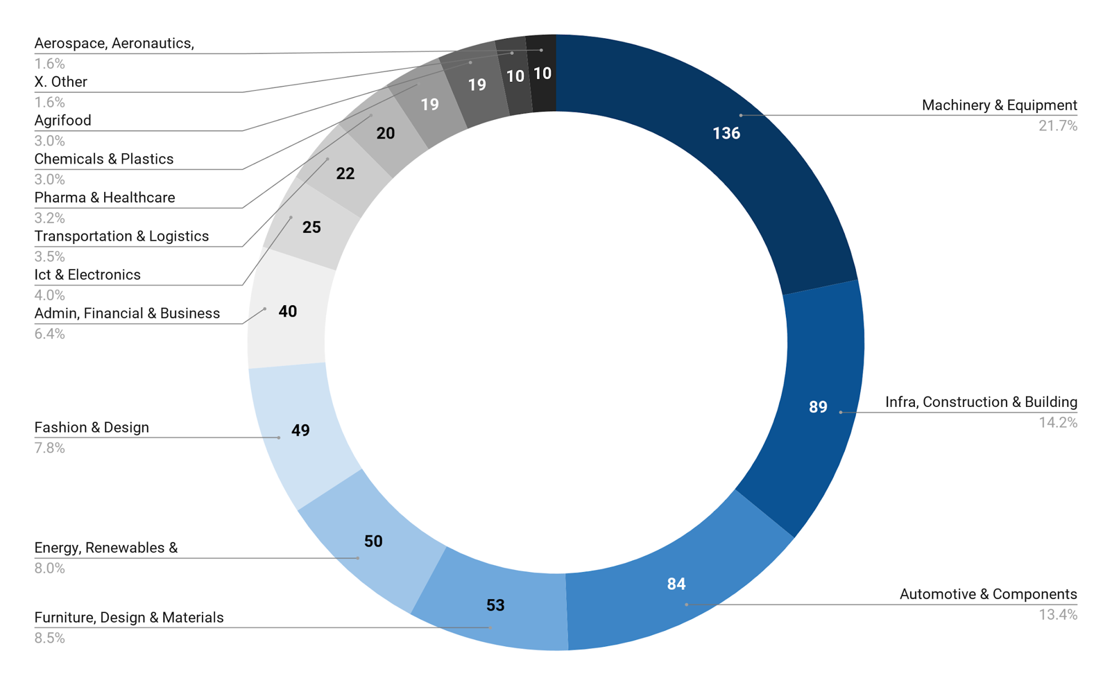
Italian Companies in India - Sectors

Slide 5
Italian Companies in India - Classiﬁcation

Slide 6
Italian Companies with Productive Plants in India - Sectors
MACHINERY &
EQUIPMENTS: 34%
270 Indo-Italian Companies with Manufacturing Units in India
OTHER SECTORS: 27%
INFRA &
CONSTRUCTION: 16%
AUTOMOTIVE &
AUTOCOMPONENTS: 23%

Slide 7
IICCI at a glance
MISSION
We are an association of Italian and Indian enterprises, professionals and intermediate bodies whose objective is to support the development of commercial and industrial collaborations between Italy and India, to promote the economic interests of both countries.
Founded in 1966
5 offices in India
30 professionals employed
CATEGORY | 2022-23
Corporate Members | 583
Individual Members | 323
Institutional Members | 20
Total Members | 926
Check our members’ directory with details of our members: www.indiaitaly.com/members-directory

Slide 8
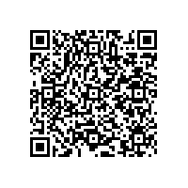
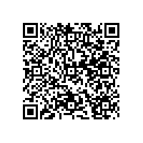
2023 VALUE PROPOSITION
MEMBERSHIP
SERVICES
TRAINING
Representation
Advocacy & Lobbying (Indo-Italian and Indo-European)
Visibility
Inclusion in the list of IICCI members
Participation in IICCI specific industry/activity events and committees
Right to nominate for the Enterprise Awards
Institutional co-branding (for Gold/Platinum/Diamond Members)
Access
To the IICCI network for preliminary assistance to enterprises
To updates on Indo-Italian news, trade, investments at macro and sector level.
Visa services
Support in submitting documents for business visas in Italy.
Fast Track service for appointment
travel services
Corporate discounts on ITA Airways flights
Market Intelligence and entry strategy
Sector/product research
Market entry strategy
Business Scouting & Matching
Search for partners and matchmaking
B2B and company visits
Startup and Operations
Company formation
location scouting, HR scouting.
Registration and approval of the product/brand.
Co-working space in Mumbai.
Branding and promotions
Digital campaigns
Product launch, exhibition and demo
Events that showcase Italian brands
Translation of documents and manuals
Italian language courses
Basic and advanced levels
Tailored programs on the Italian language for business
Vocational training
For promoters of Italian food and wine products
For machine operators
Experiences, training and study trips
Italian universities
Italian wineries and food producers
Italian motorcycle and car companies
Click on the QR Code to fill out the form and join the IICCI
EURO
INR
GOLD/PLATINUM/DIAMOND MEMBERSHIP
An upgrade for brand identity co-branding activities, for a constant presence of the logo in all IICCI promotional material.

Slide 9
IICCI new home in MUMBAI
VIVITALIA – Experience Center in Mumbai is a +350m2 space in a prestigious location in the pulsating heart of Mumbai.
It is exclusively dedicated to the promotion of Italy its lifestyle culture and brands

Slide 10
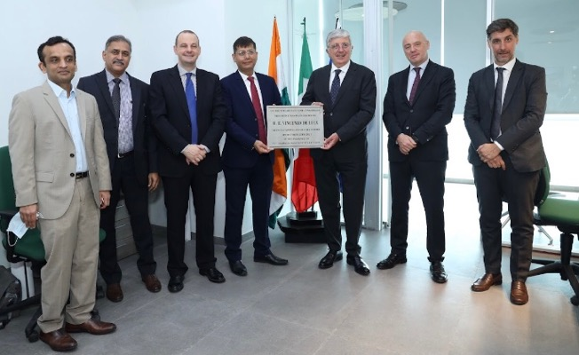
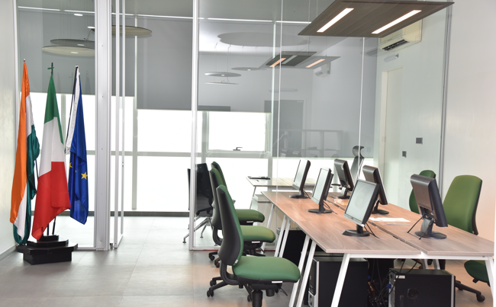
IICCI new home in MUMBAI

Slide 11
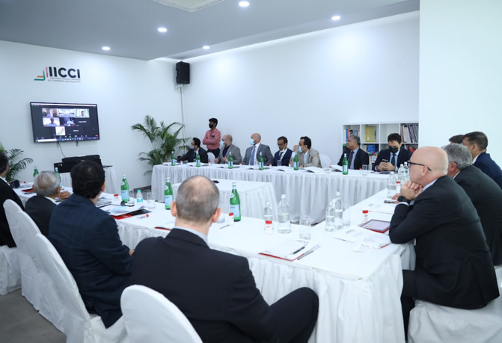
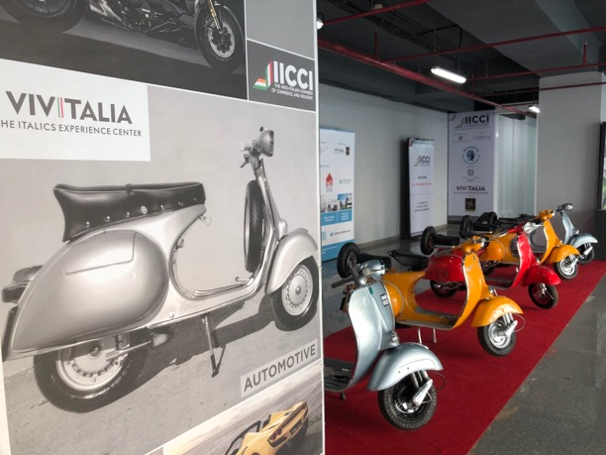
IICCI – VIVITALIA | Events and Experience Center

Slide 12
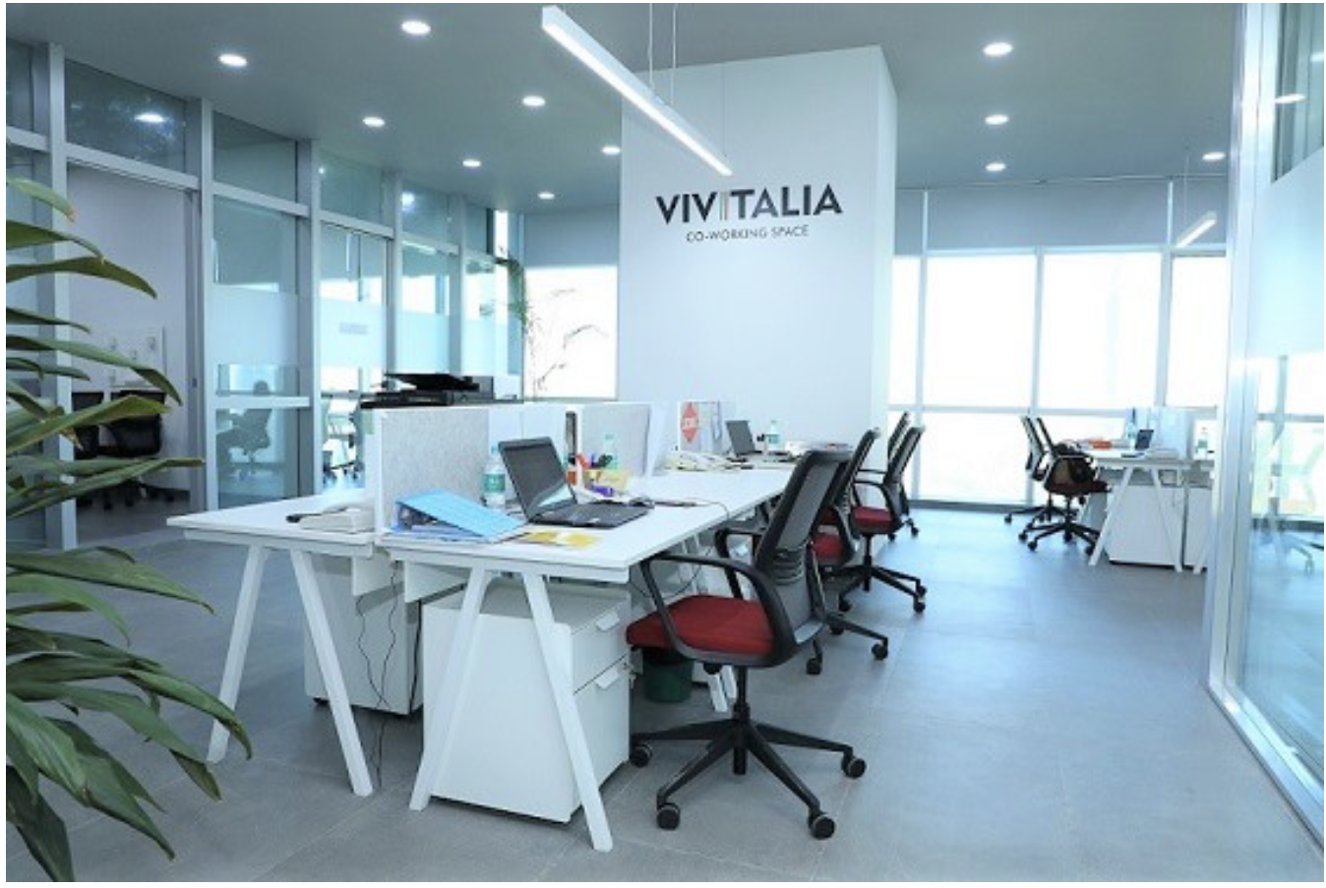
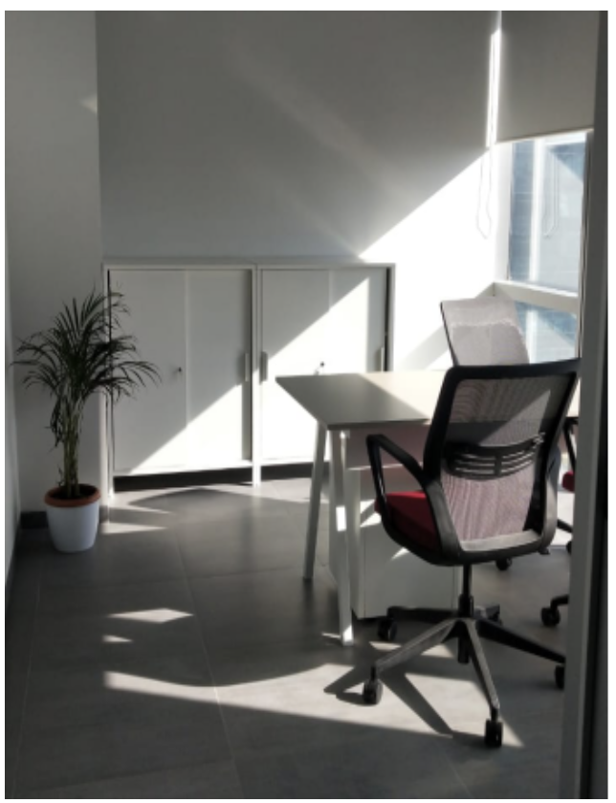
IICCI – VIVITALIA | Co-Working Space

Slide 13
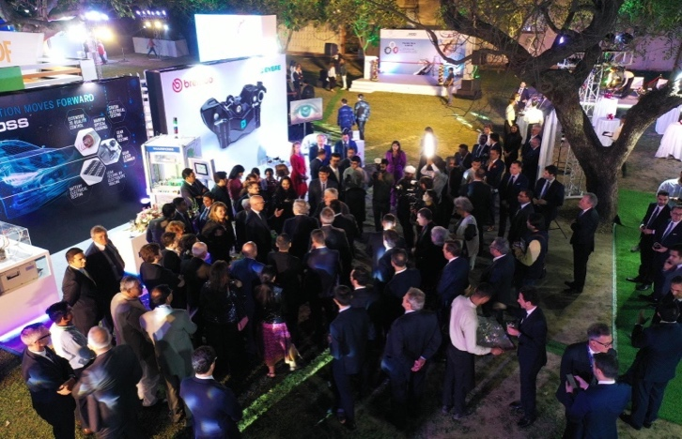
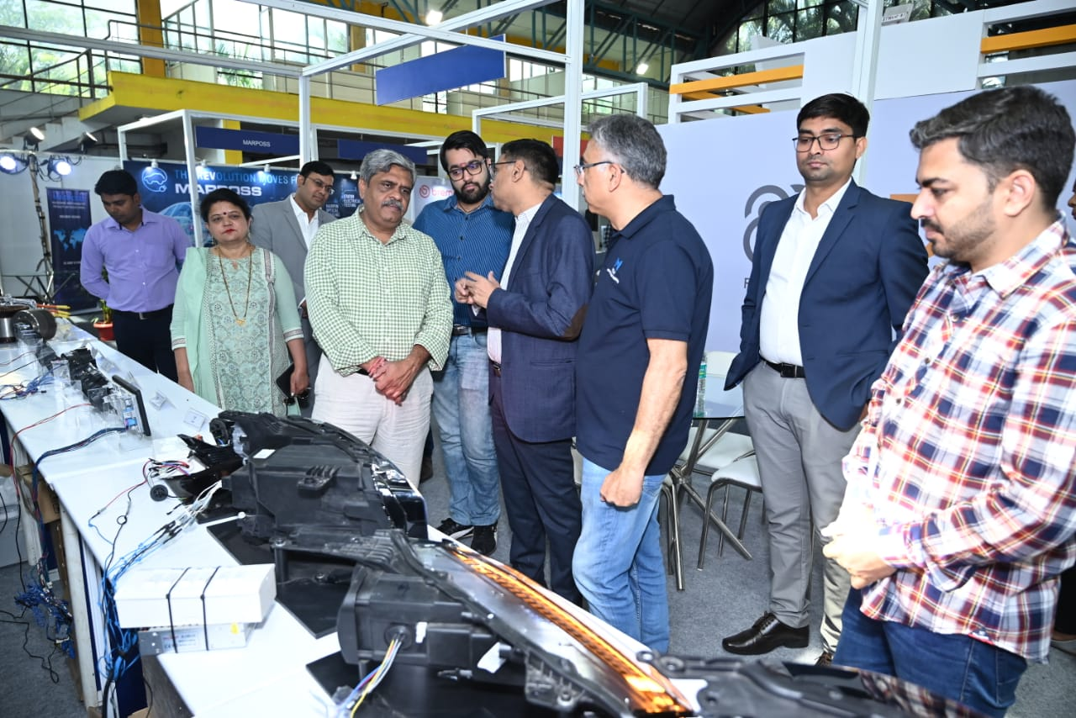
IICCI Eventi Flagship – Italian Tech in India
ITALIAN TECH in INDIA e’ una mostra di tecnologie e prodotti realizzati in India da imprese italiane in settori di interesse strategico: macchinari e manifatturiero, automotive e autocomponentistica, tecnologie per l’agroindustria, engineering per energia, infrastrutture e costruzioni

Slide 14
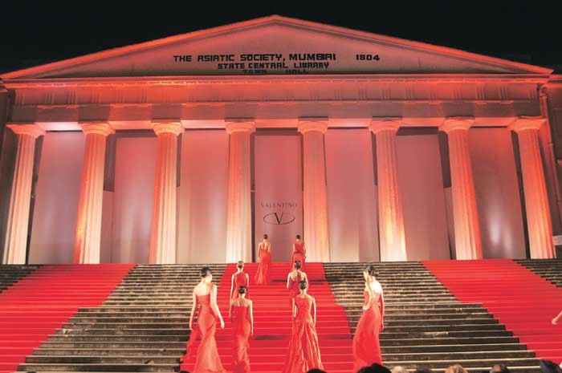
IICCI Eventi Flagship – FESTA ITALIANA
FESTA ITALIANA e’ una celebrazione del Made in Italy e dello stile di vita italiano, che presenta marchi italiani in India nel settore della moda e accessori, arredo e design, agroalimentare, automotive, formazione e cultura.

Slide 15
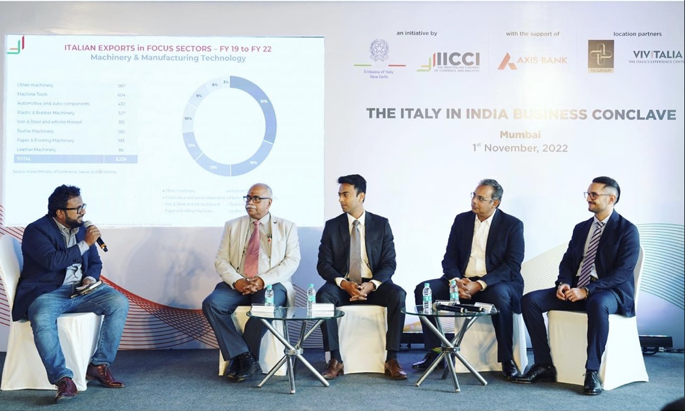
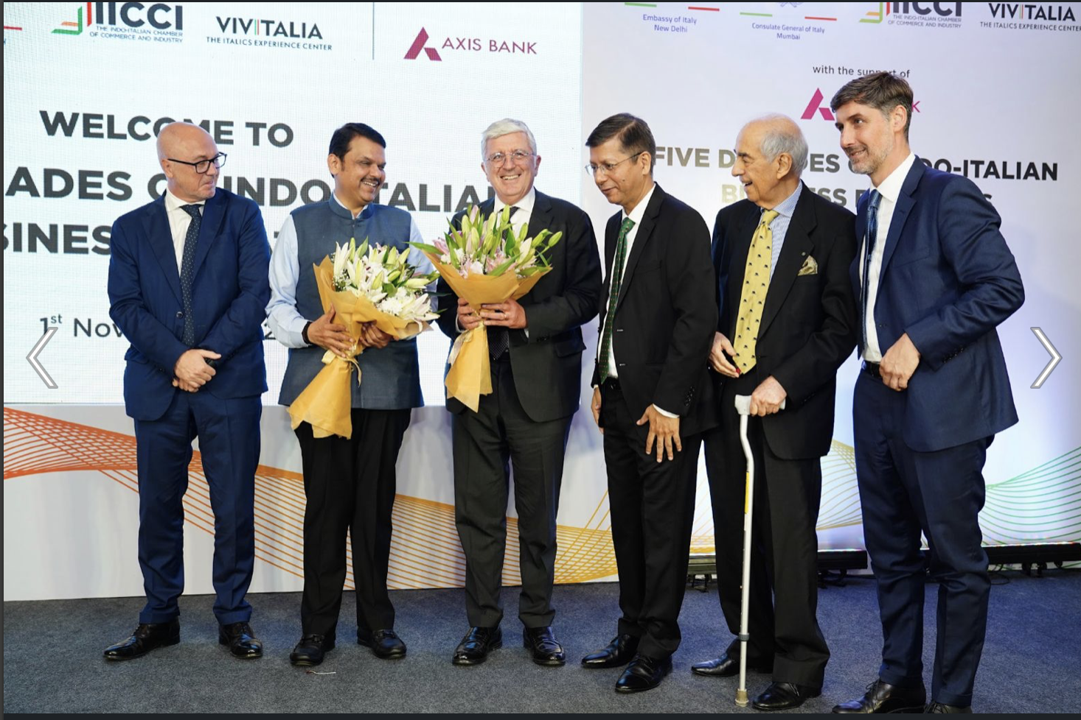
IICCI Eventi Flagship - The Italy in India Business Conclave

Slide 16
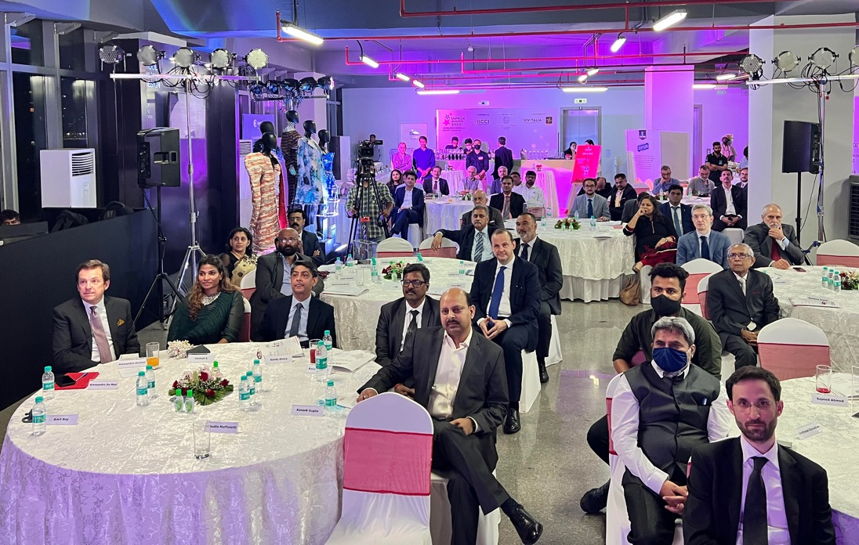
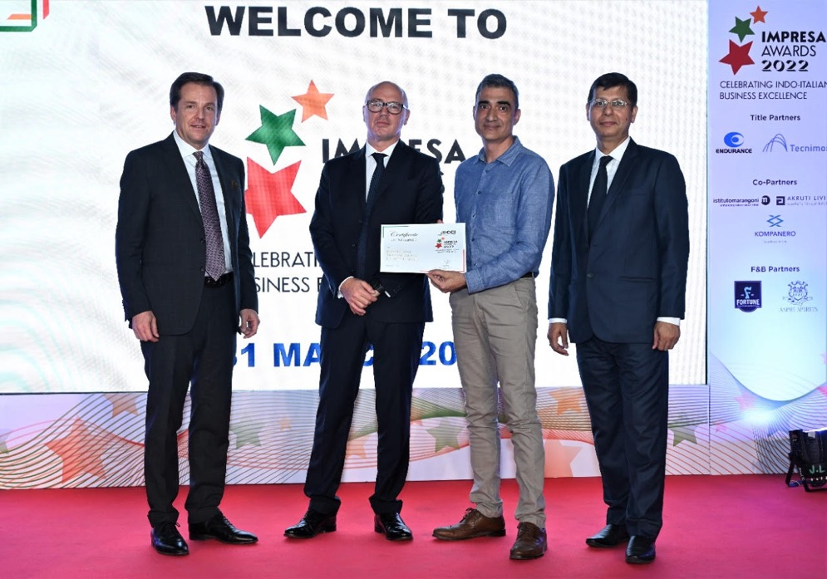
IICCI Flagship Event – IMPRESA AWARDS

Slide 17
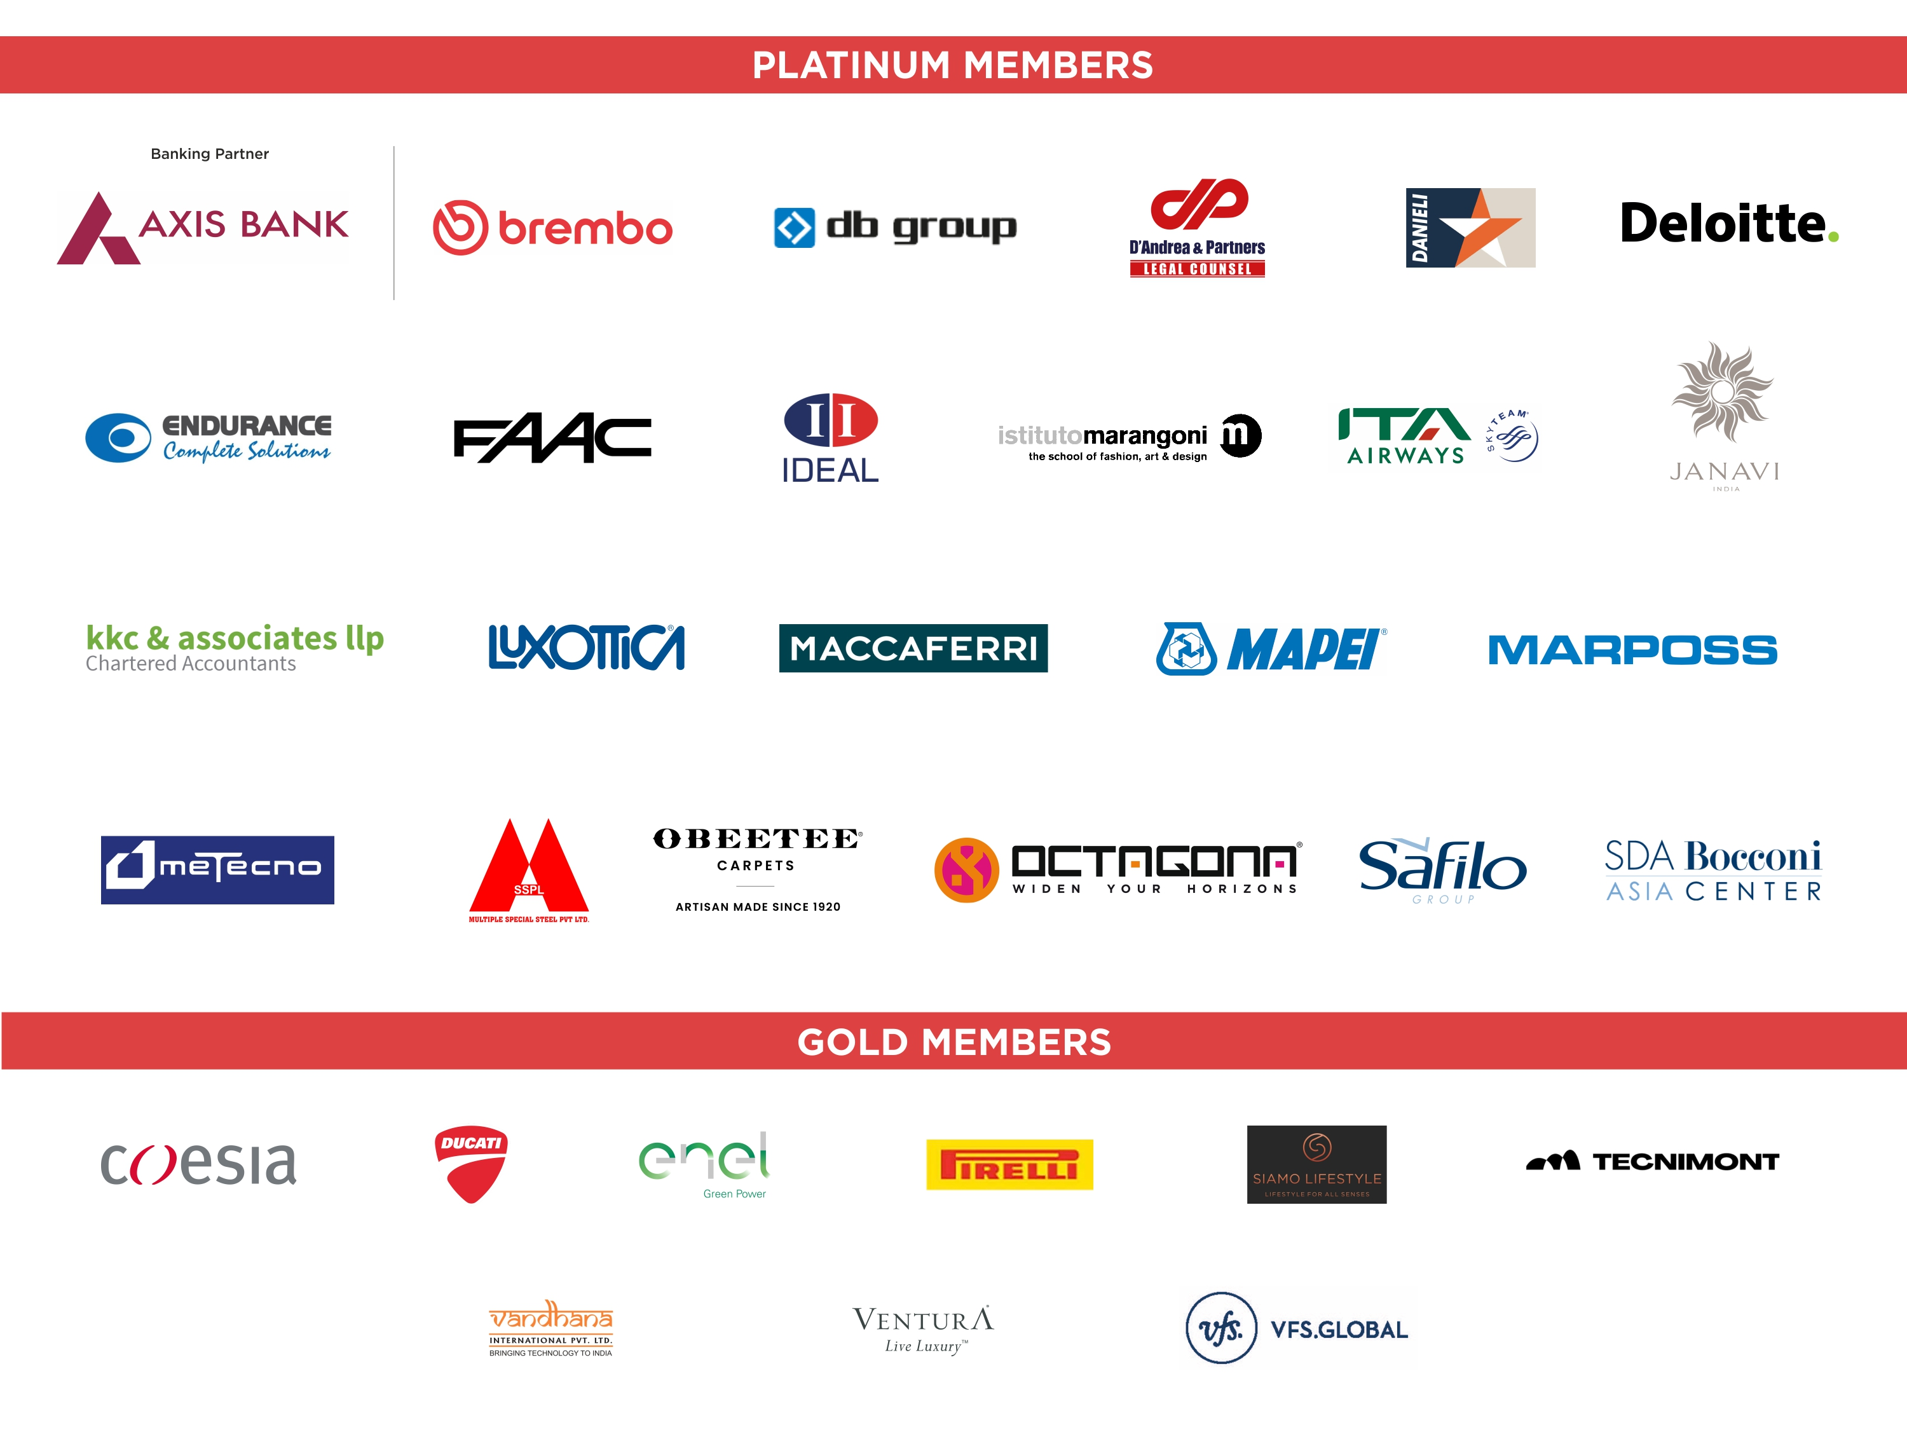
This presentation, and all the projects, events, initiatives and activities organised by the IICCI – Indo-Italian Chamber of Commerce and Industry, would not be possible without the support of our members and of the Indo-Italian business community. Amongst them, our Platinum Members & Partners, deserve a special mention.

Slide 18
GRAZIE
IICCI - The Indo-Italian Chamber of Commerce and Industry
c/o VIVITALIA - 11th Floor, Urmi Estate, 95, Ganpatrao Kadam Marg, Lower Parel West, Mumbai 400013, Maharashtra
P: +91 2267728186 | E: iicci@indiaitaly.com | W: www.indiaitaly.com

